Slide 1
Authorization using Access control list
Objective: Having hands-on experience on Securing Router Administrative ACL using Packet Tracer.
Scenario: Any one try access Finance web server they are not allowed only Admin PC is allowed to access.
Two type of ACL
Standard Access-list
These are the Access-list that are made using the source IP address only. These ACLs permit or deny the entire protocol. using numbers 1-99 or 1300-1999, the router will understand it as a standard ACL and the specified address as the source IP address.
2.Extended Access-list These are the ACL that uses source IP, Destination IP, source port, and Destination port. These use range 100-199 and 2000-2699.

Slide 2
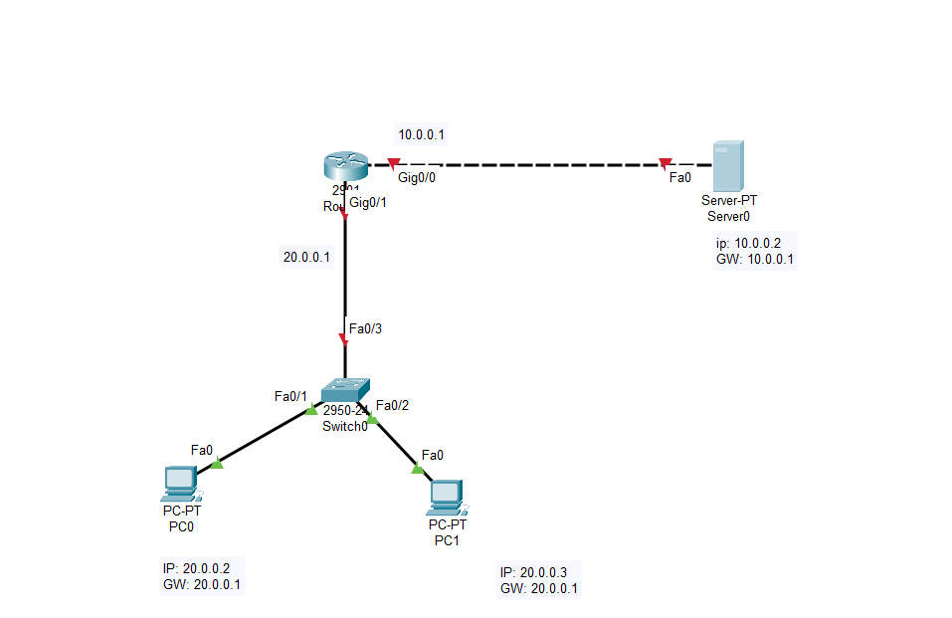
Step1: Place the devices and connect them through the auto connection cable

Slide 3
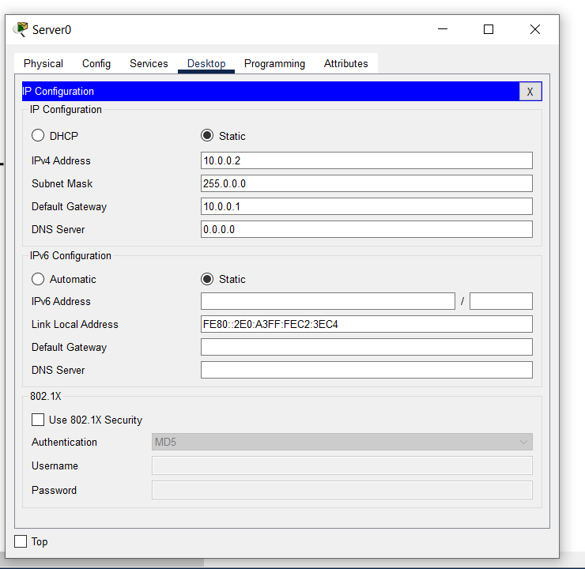
Step 2: Assign Ip address, subnetmask and GW Server IP configuration

Slide 4
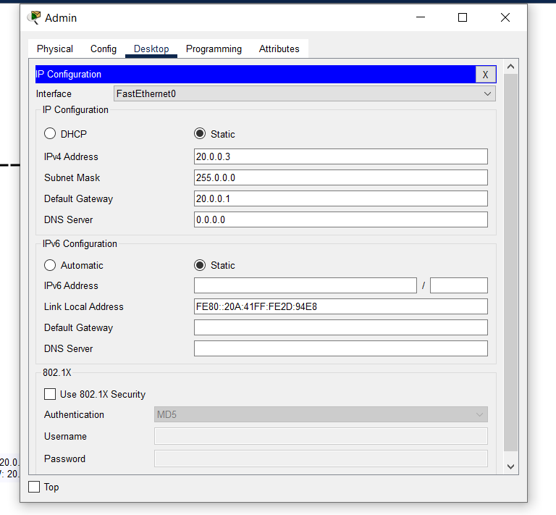
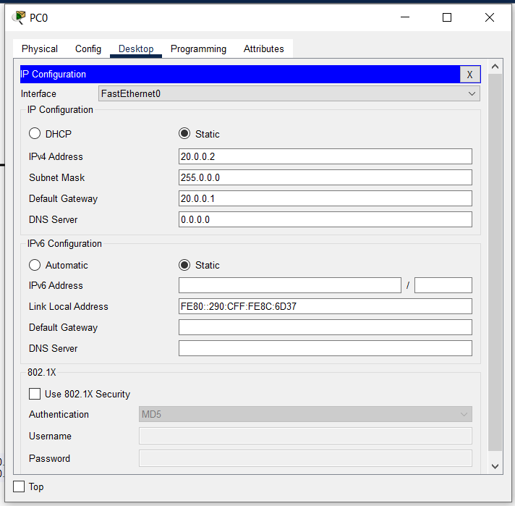
The admin and the pc IP configuration setup

Slide 5
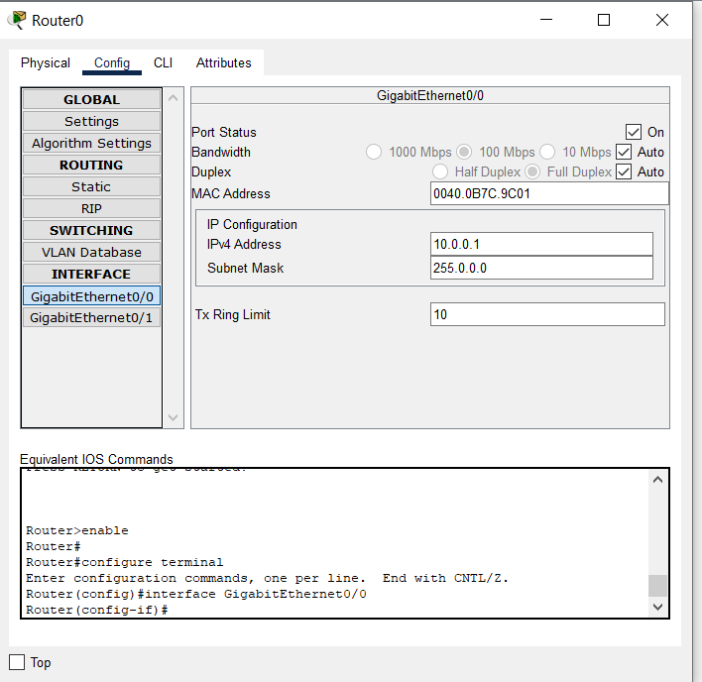
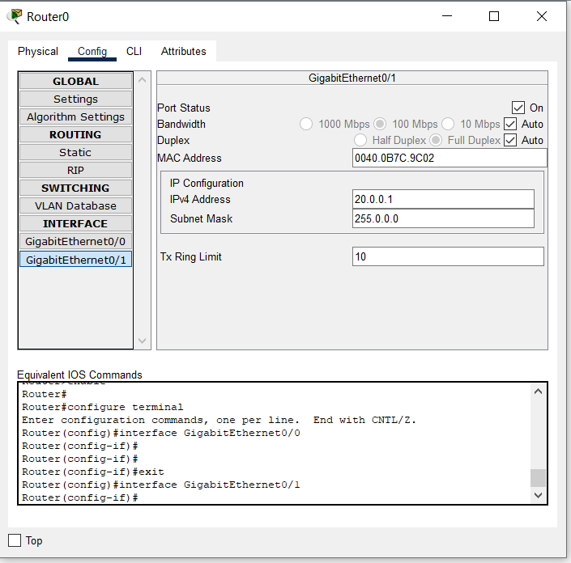
Router setup

Slide 6
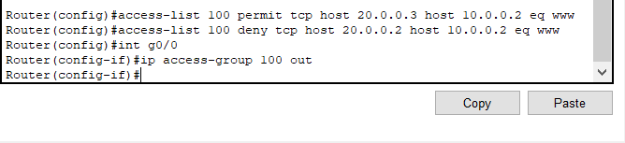
Step 3: Configure the router with the ACL commands
One user (Admin) is allowed to access only web server. For this requirement we need two statements. First statement allows admin host 20.0.0.3 to access Finance web server. Second deny user host 20.0.0.2 to access Finance web Sever
Create ACL as per the requirement, apply it on the interface using “ip access-group 100 out”
Syntax : access-list {extended ACL number} {permit/deny} {tcp/udp} {src-host} {src-ip} {dst-host}{dst-ip} {eq}{www}

Slide 7
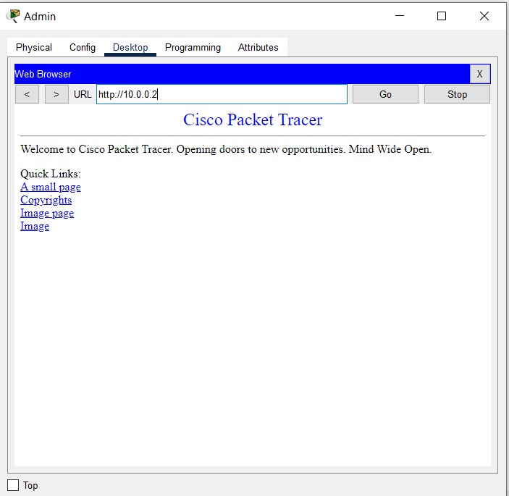
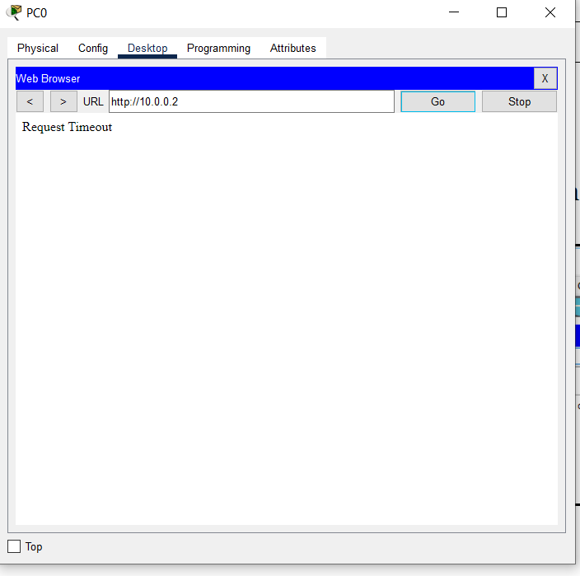
Step 4: Access the web server Admin pc is allowed to access the web server but PC0 is not allowed to access the web server

Slide 8
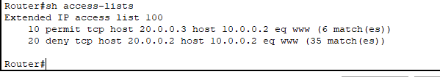
To check your ACL configuration you can use
Router#Sh access-lists
If you make any mistakes, you can remove using
Router(config)#no access-list 100

